Slide 1
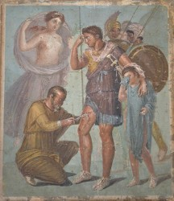
Greece and Rome History 1310
Lecture 2
Tennessee Technological University
Dr. Allen Driggers

Slide 2
Framing Questions-Guiding Points
Why could we start the class with the Greeks?
Who were some natural philosophers in ancient Greece—what did they think?
What were the contributions of Rome to engineering, natural history, and medicine?

Slide 3
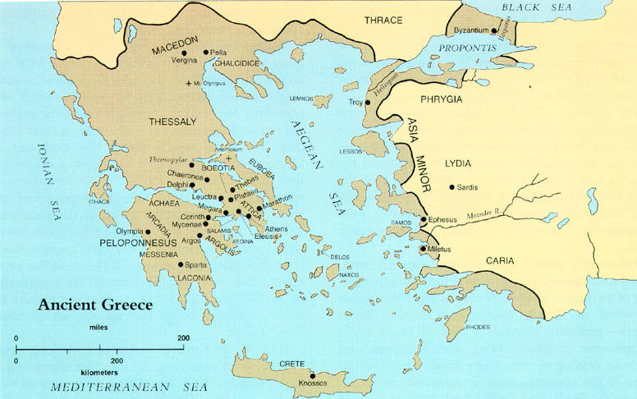
Map of Ancient Greece

Slide 4
Orientation
Why could we start with the Greeks?

Slide 5
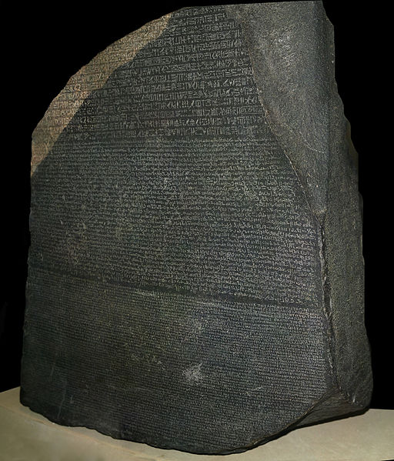


Slide 6
Greeks 2
Natural Philosophy?
Abstraction v. practical thought?
Natural philosophy is disaggregated (spread out/not organized) like their culture/city states

Slide 7
Groups of Natural Philosophers
General Chronology of Philosophers:
Pre-Socratics (those philosophers who come before Socrates, LOL)
Socrates
Plato
Aristotle

Slide 8
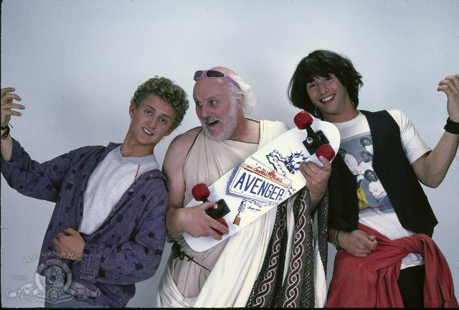

Slide 9
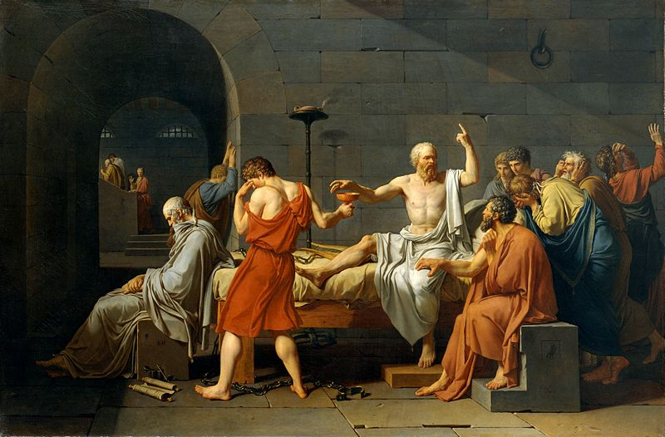
Socrates 470 BCE to 399 BCE--Athens

Slide 10
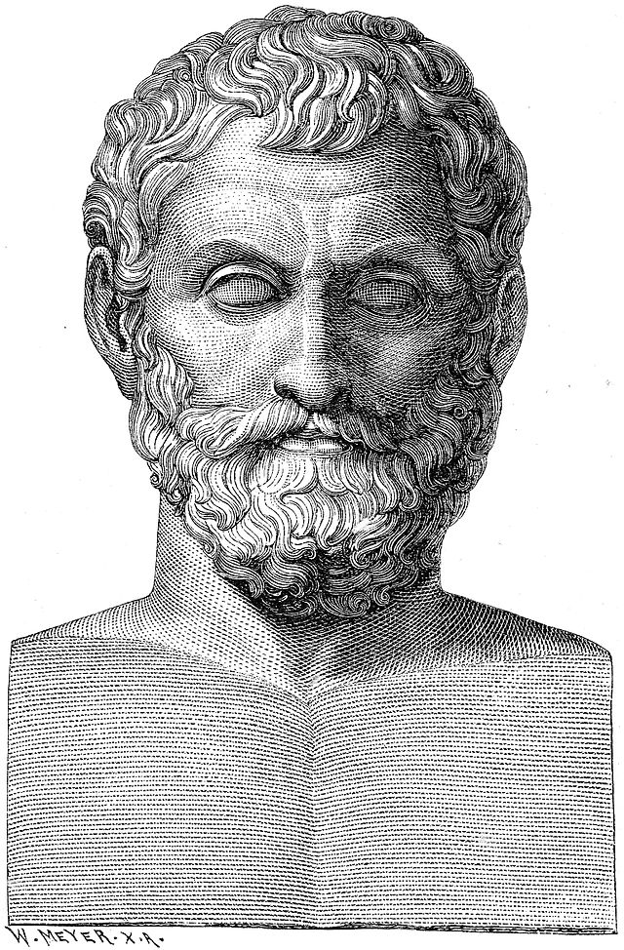
Thales (624-546 BCE)
Rational laws v. religion
Metaphysics
Claims about nature
Had a slogan that summed up his ideas.

Slide 11
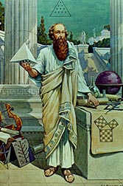
Pythagoras (570-495 BCE)
Math
Conception of the world
Theory
proof—something must be logical if every step further argues the logic of an idea—leading to the Q.E.D. quod erat demonstrandum, or thus proven

Slide 12
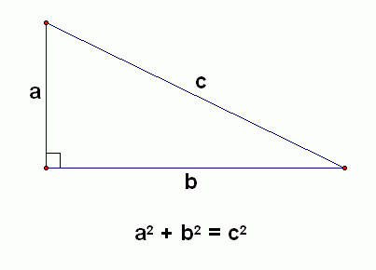
Pythagoras 2

Slide 13
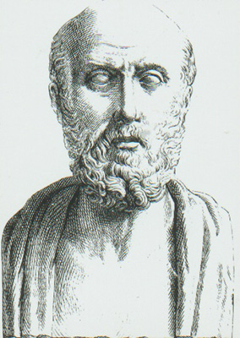
Hippocrates (460-370 BC)?
Physician
Theory of the
4 Humors

Slide 14
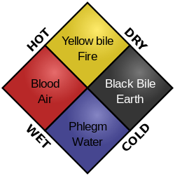
Hippocrates 2

Slide 15
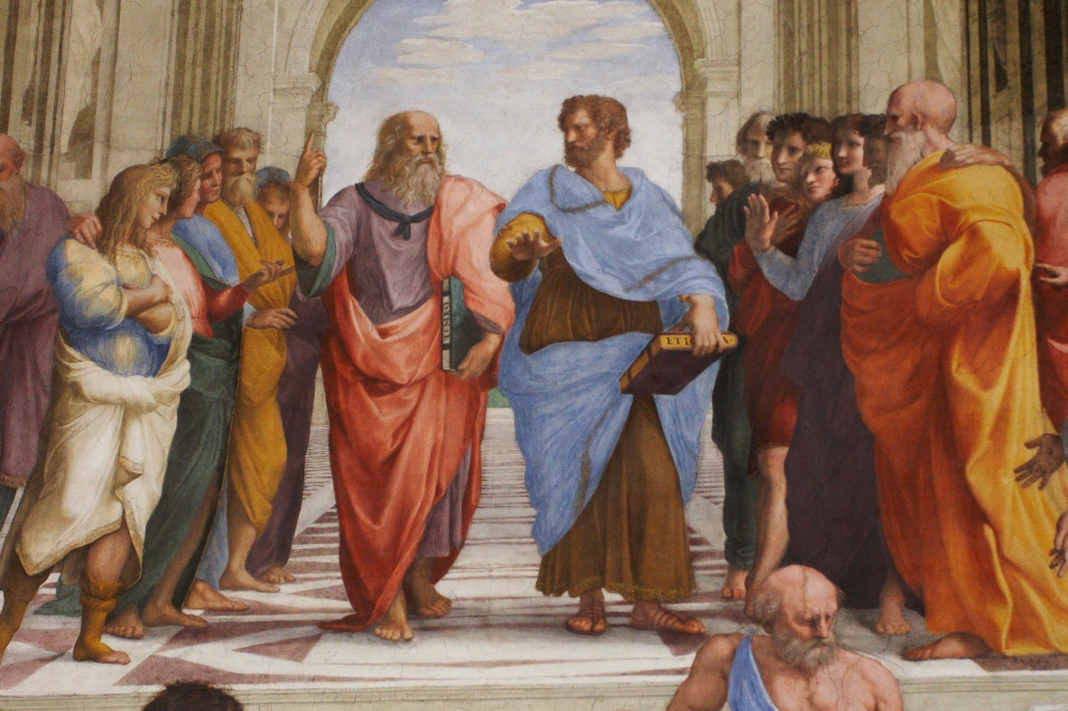
School of Athens by Raphael (circa 1510)

Slide 16
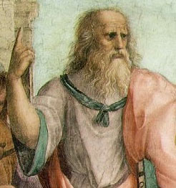
Plato
Student of Socrates
“Let no one enter here who is ignorant of geometry.”
Perfection!
Look for the perfect form.
All about starting inquiry with “first principles”

Slide 17
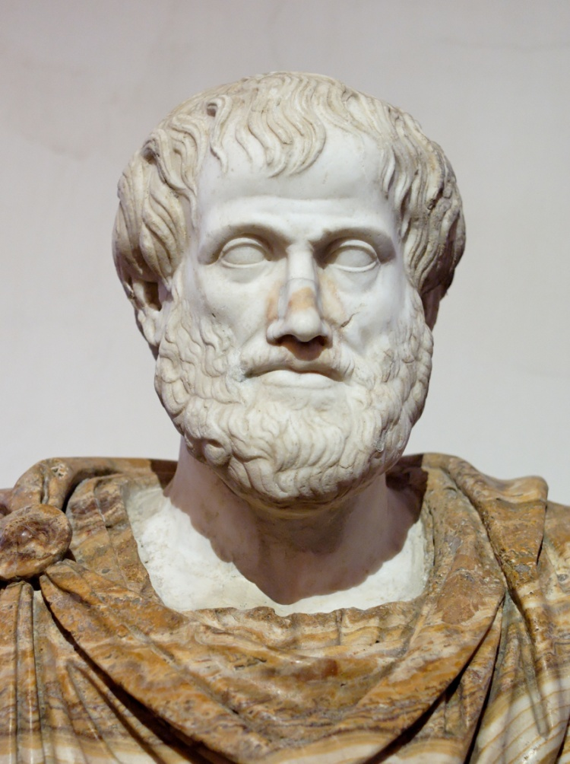
Aristotle (384-322 BC)
Observation—everything of the earth
Empiricism
Wrote a lot!
Chain of being
Rationality?

Slide 18
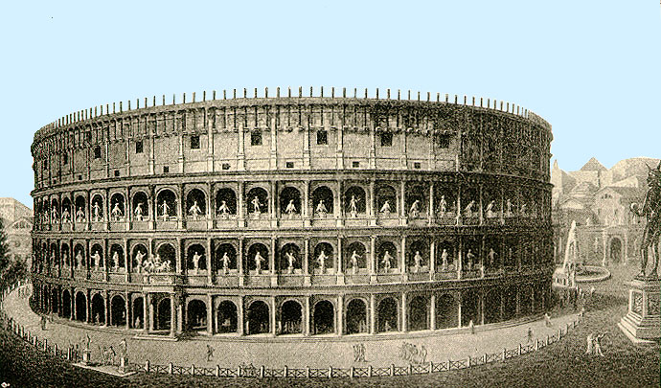
Rome

Slide 19
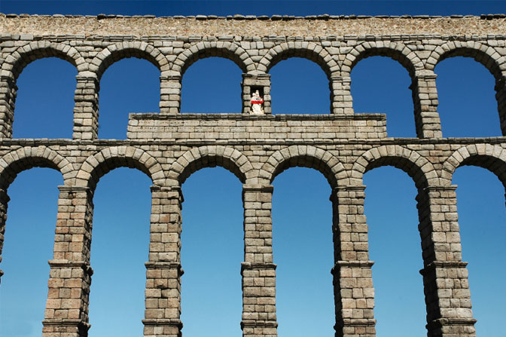
Rome 2

Slide 20
Rome
An empire that existed between 27 BC and 476 AD; though the Eastern part of the empire existed into the fifteenth century.
Did the Greeks actually conquer the Romans?
Culturally?

Slide 21
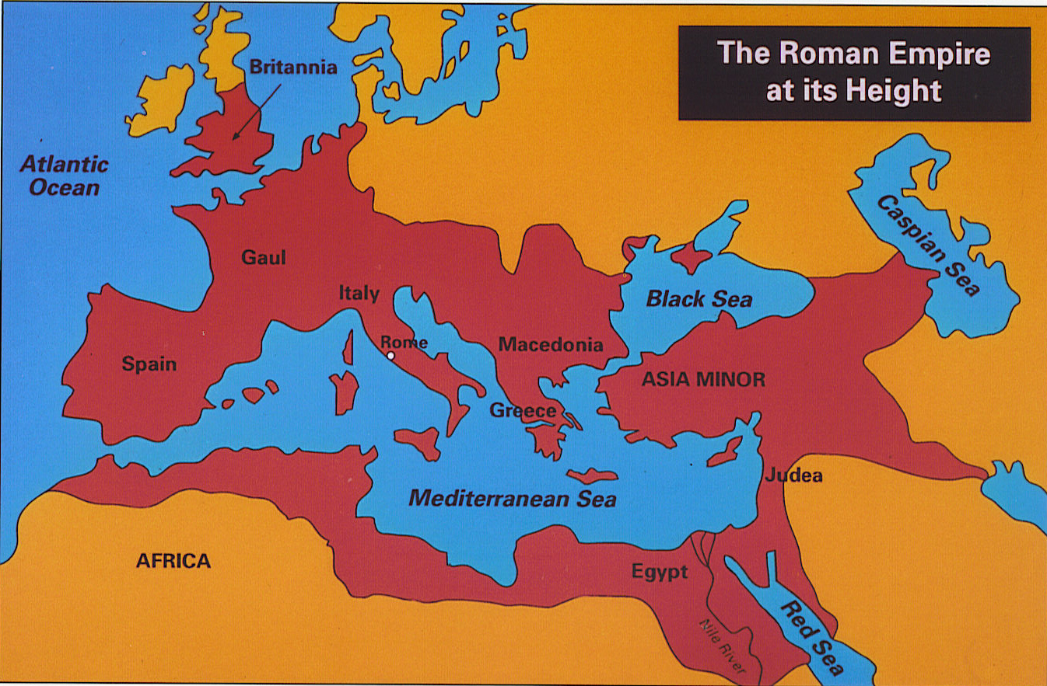
Map of Rome

Slide 22
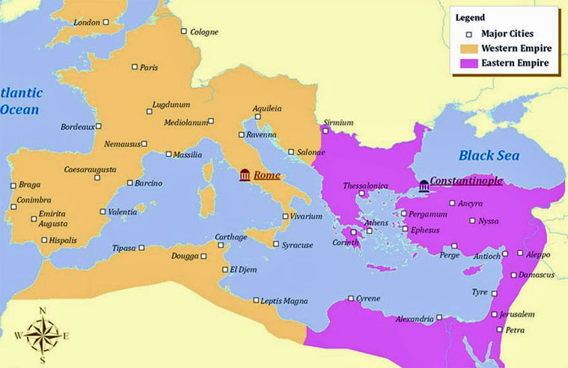
Rome: Eastern and Western Empires

Slide 23
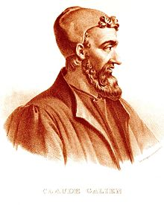
Galen (129 AD to 216 AD)
Dissection of gladiators
Anatomy
Refinement of the humors

Slide 24
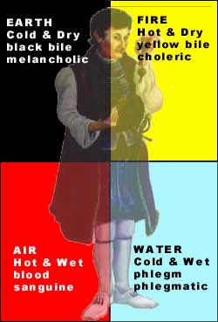
Further refining of humoral theory

Slide 25
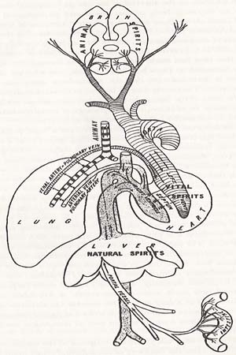
Humoral Physiology

Slide 26
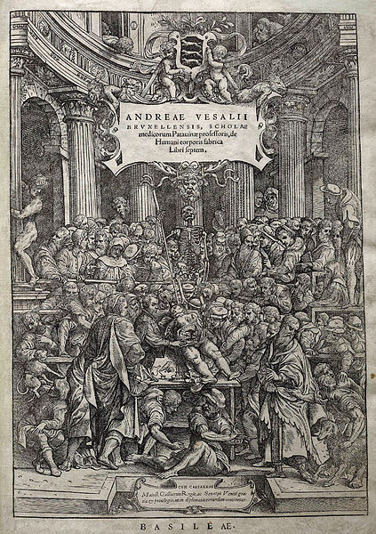
Vesalius

Slide 27
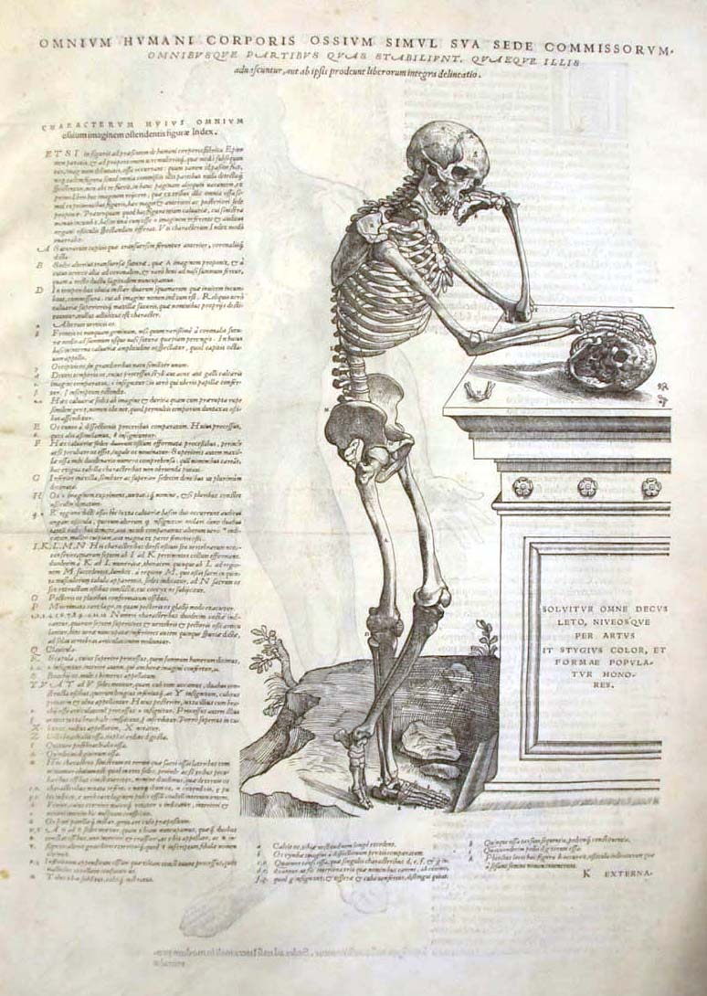
“Seeing” the human body

Slide 28
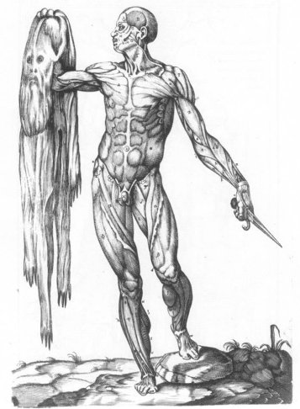
Art & Science

Slide 29
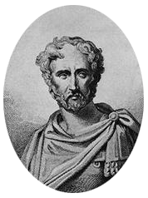
Pliny the Elder (23 CE to 79 CE)
Wrote the encyclopedic work “Naturalis Historia”
one of the few completed works that survived the Roman Empire.
Model for “natural history”

Slide 30
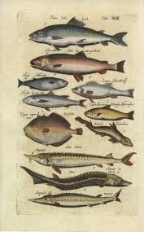
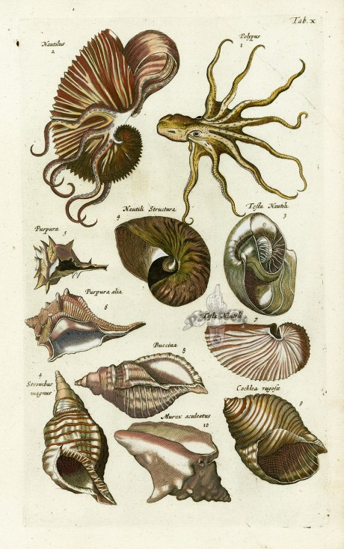
Pliny 3

Slide 31
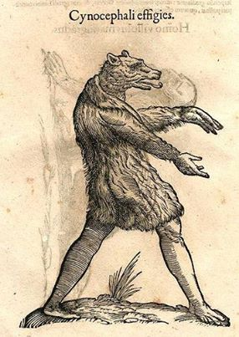
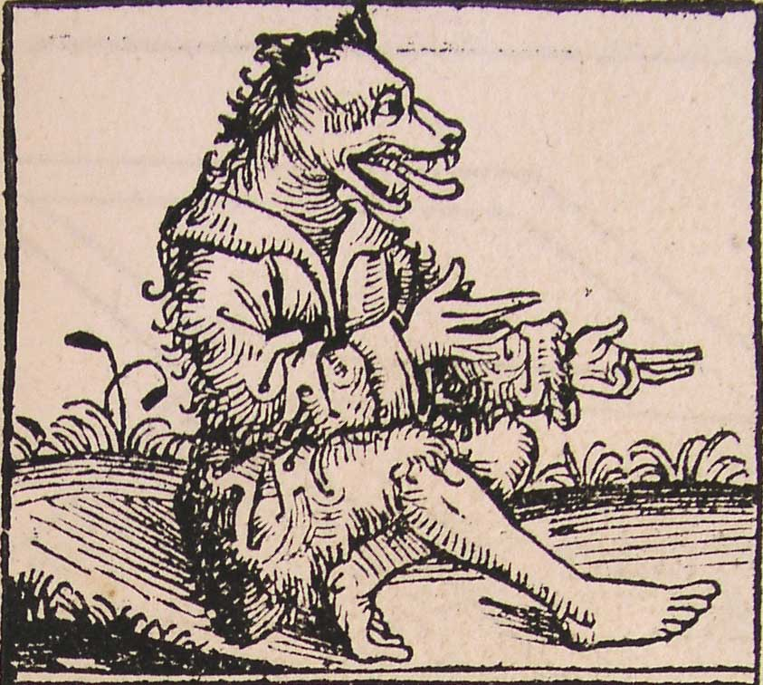
Pliny 4

